Slide 1
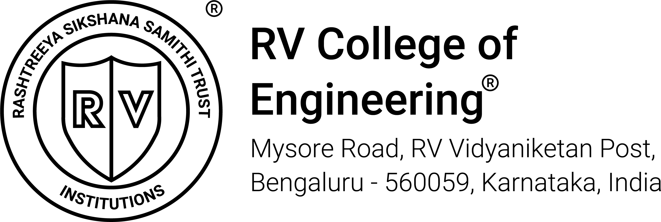
BUILD WITH GEN AI HACKATHON
Team ID : RVGEN52
Team Name: Code Crew
Team Members: Pavana Reddy Vatte, P.Nityashree, Ramagovini Pavani

Slide 2
PROBLEM STATEMENT:
How can AI assist NGOs in planning efficient food distribution systems for urban slums?
Due to ineffective distribution channels, improper storage and poor planning, food that is distributed or donated often gets wasted.
Many people in rural areas are not aware of government schemes or available food resources and that food also goes into waste many a times.
Overcrowding in slums also makes it difficult to ensure that food reaches all the residents.

Slide 3
SOLUTION:
NGOs act as intermediates between govt food schemes, corporate food donations, surplus donations from common people. Using AI, we can create a mobile or a web app with UI that helps NGOs collect food as well as distribute it efficiently.
Using this app NGOs can collect data about urban slums, their location and a rough estimate of the population.
Apart from this, people interested in donating food (leftovers from events, specially prepared meals for donation, raw materials that did not make it to the market, surplus stock in stores etc.) can notify the NGOs about the same and NGOs can further plan about the distribution of the food by checking the locations of the slums in need.

Slide 4
The following details can be incorporated for user interface:
DEFINE data structures:
-DonorList: List to store donor details (name, location, food type, quantity)
-ReceiverList: List to store receiver details (name, location, needs)
-DistributionLog: List to store records of distributed food
-FoodInventory: Dictionary to track available food by type and quantity
-MapMatrix: Graph to represent locations and distances between donors and receivers
INITIALIZE system settings:
-MaxDeliveryTime: Maximum time for delivery
-Volunteers: List of available volunteers
-DeliveryVehicles: List of available vehicles

Slide 5
KEY TAKE AWAY:
NGOs can keep track of the food status and needs at the slums and assign food distribution according to the reserve.
NGOs can accept the donations from people and appreciate them for their efforts in contributing. If interested people can collect location details from the app as well.
Wastage in government food schemes, events, surplus stocks at store can be used efficiently.
Anyone willing to donate food but cannot go directly due to time, distance and other constraints can also contact the NGOs regarding the same. They can also infer data regarding the approximate time for delivery and vehicles available.

